Slide 1

KNU-support
Final (2020.12.10)
Real-time matching app
for the disabled
Team 2
- Team: Potato searchers
- Team leader: Jin-kyung Kim
- Team member: Yoon-hee Kang, Su-hyun Yoon, Sang-ryul Heo, Ye-na Hong

Slide 2
Index
Introduction
App Development Project
Description of how the app works
Wireless remote controller for the blind
Conclusion
Gantt chart

Slide 3



1. Introduction
Increased interest for the disabled
Many welfare services follows along the increase

Slide 4


1. Introduction
Underlying problems
cannot always be on standby
Have limited functions
-> Designed an app to solve these problems

Slide 5



1. Introduction
Main functions
APP
Real time search for
Personal support
Accommodations for the disabled
Wireless Bluetooth
remote control

Slide 6

1. Introduction
Main functions

Slide 7


2. App Development Project
Authentication
Remote Config
Cloud Messageing
Save Chatting
GPS Information
Kindness
Ask Help Information
Apache
Member Information
NGINX
Member Information
Community Board
1st Semester
2ndSemestser
Functional Extension

Slide 8
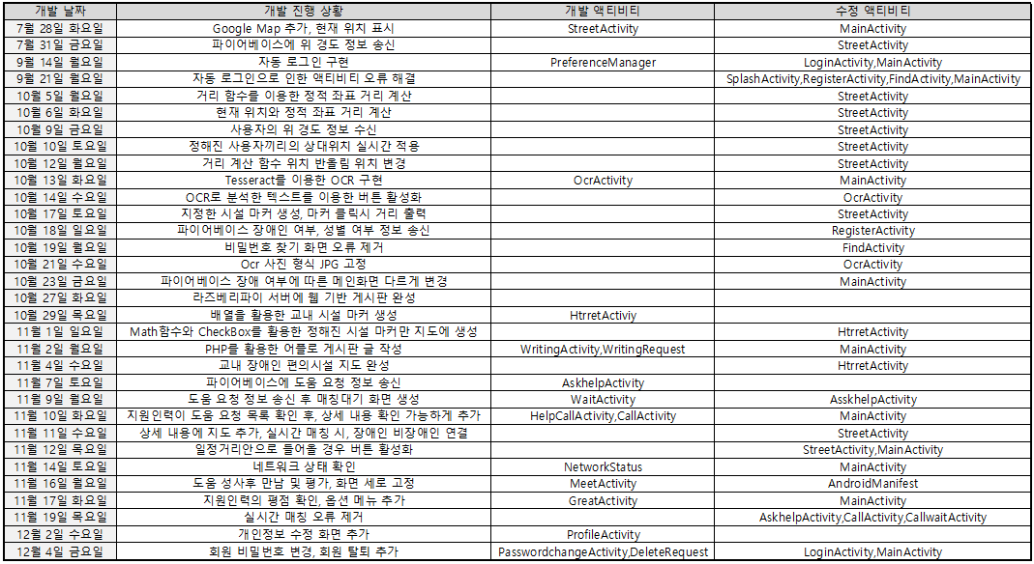
2. App Development Project
2nd Semester Project Development Diary

Slide 9
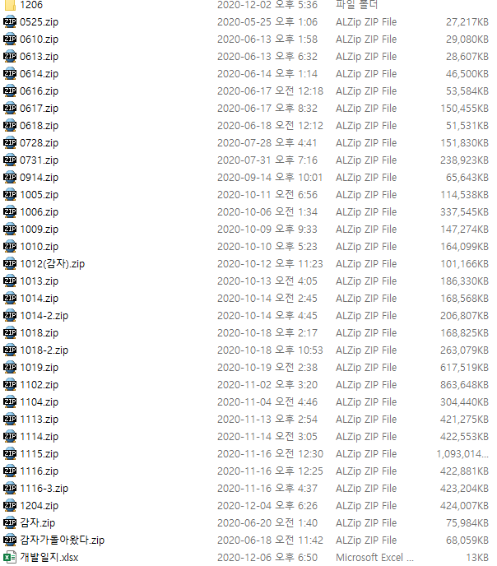
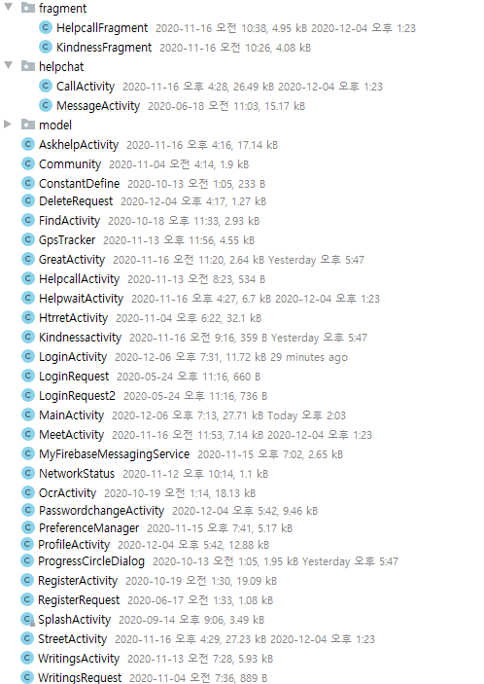
2. App Development Project
2nd Semester Project Development Status
34개의 액티비티
29개의 레이아웃

Slide 10
2. App Development Project
2nd Semester Project Development Functions
Sharedpreferences: Auto Login, Save real-time matching time
GPS, Array, Marker: Real-time location, Disability Convenience Facility Map
OCR: Certificate confirmation
Firebase Database: Ask help, Kindness, GPS etc Information transmit and receive
PHP Database: Member Information, Community Board transmit and receive

Slide 11

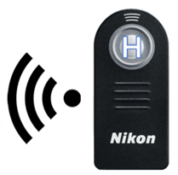
3. Description of how the app works
Editing Profile
Kindness Score & Check Usage History
Logout
Ask Help → Accept/Refuse → Real-Time Location Sharing & Chatting
Ask Help /
Write a Review
Wireless Remote Control for Blind person
Simple Writing is Possible / Posts Can be Checked Through Web View
Map of Accomodations for disabled
Arduino and Bluetooth is main

Slide 12

3. Description of how the app works
Ask for Help
Disabled
Non-disabled
<MainActivity>
<MainActivity>

Slide 13
3. Description of how the app works
Ask for Help
Disabled
Non-disabled
<MainActivity>
<MainActivity>

Slide 14
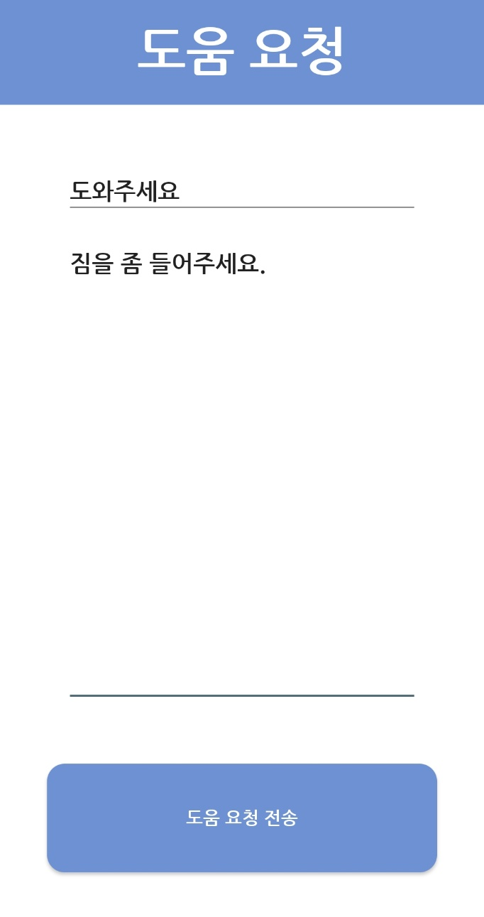
3. Description of how the app works
Ask for Help
Disabled
Non-disabled
<AskhelpActivity>
<MainActivity>

Slide 15
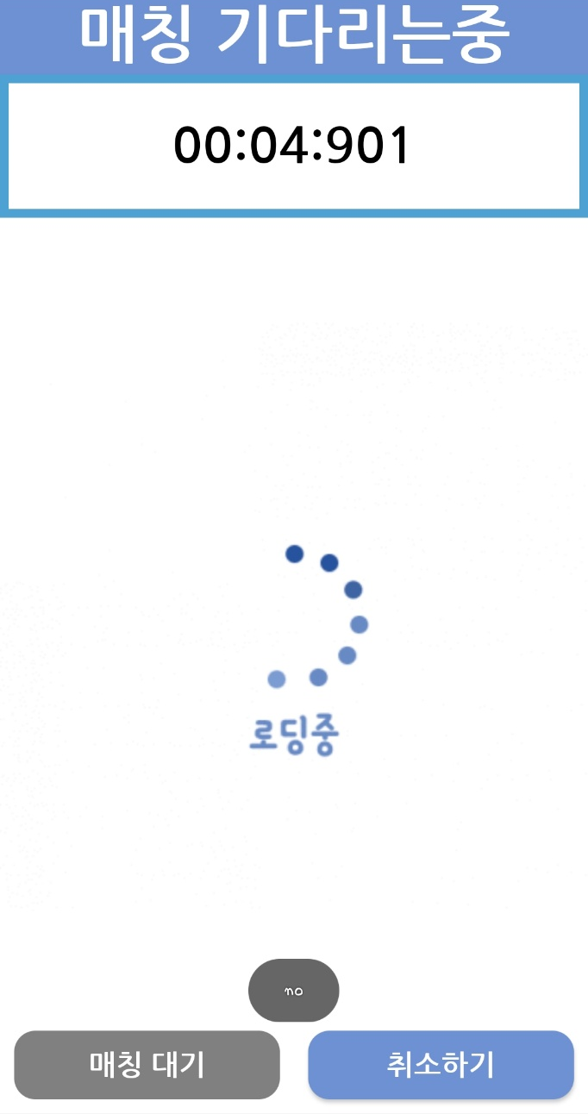

3. Description of how the app works
Ask for Help
Disabled
Non-disabled
<HelpwaitActivity>
<HelpCallActivity>

Slide 16
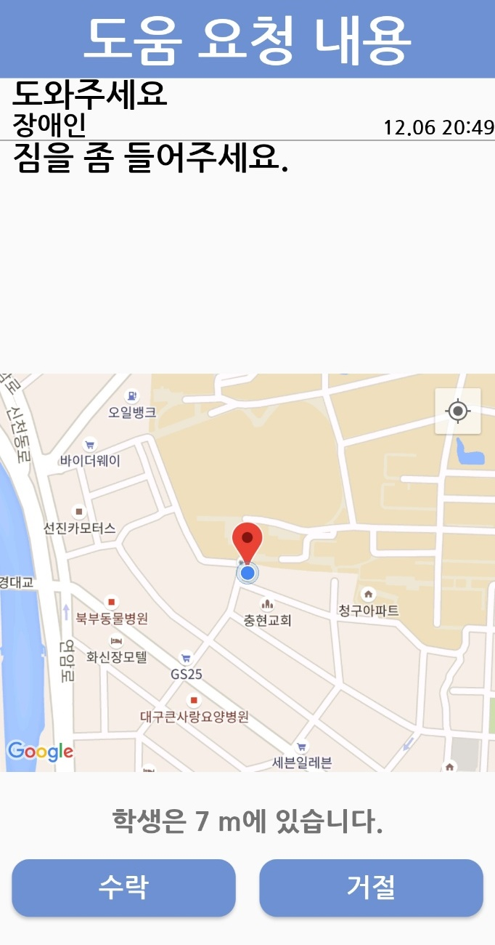
3. Description of how the app works
Ask for Help
Disabled
Non-disabled
<HelpwaitActivity>
<CallActivity>

Slide 17
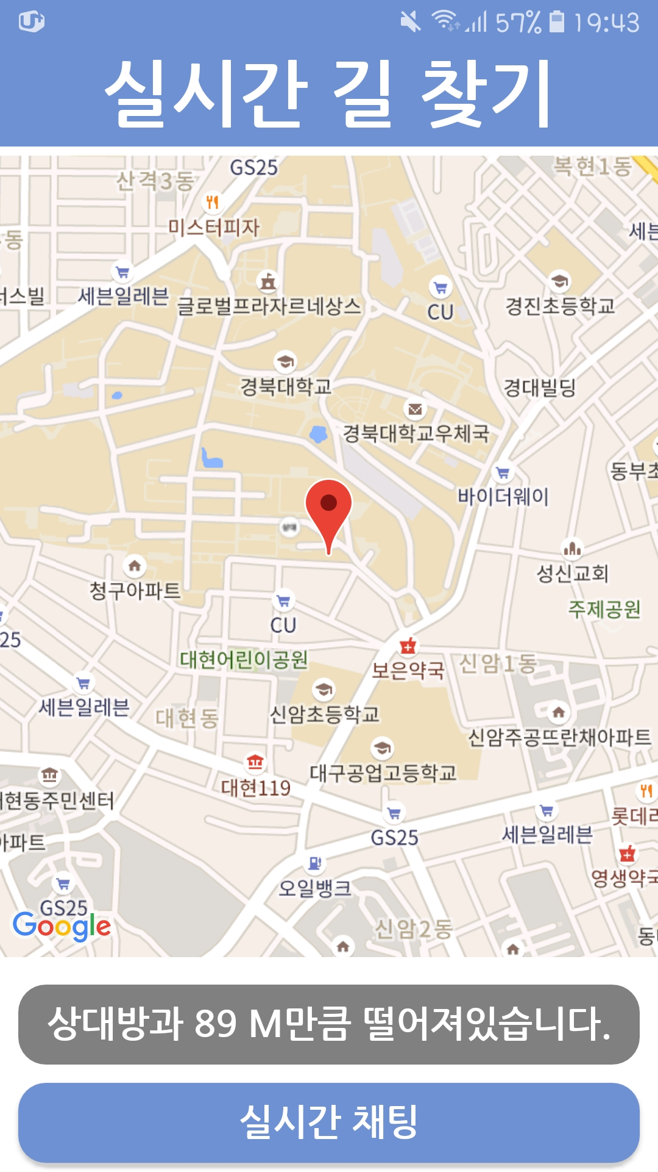
3. Description of how the app works
Ask for Help
Disabled
Non-disabled
<StreetActivity>
<StreetActivity>

Slide 18
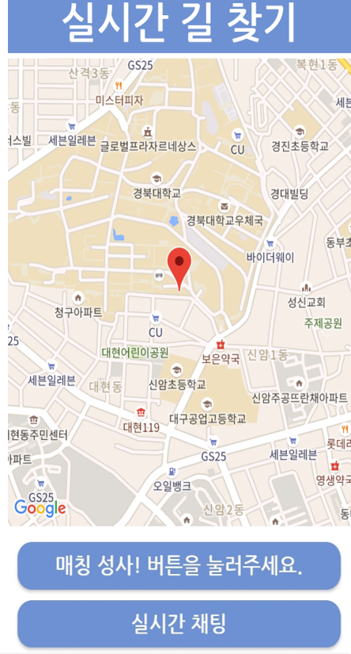
3. Description of how the app works
Ask for Help
Disabled
Non-disabled
<StreetActivity>
<StreetActivity>

Slide 19
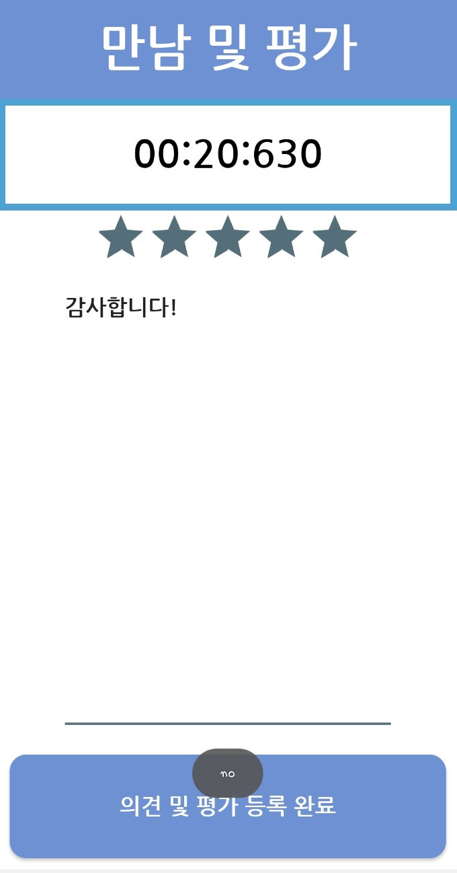
3. Description of how the app works
Ask for Help
Disabled
Non-disabled
<MeetActivity>
<MainActivity>

Slide 20
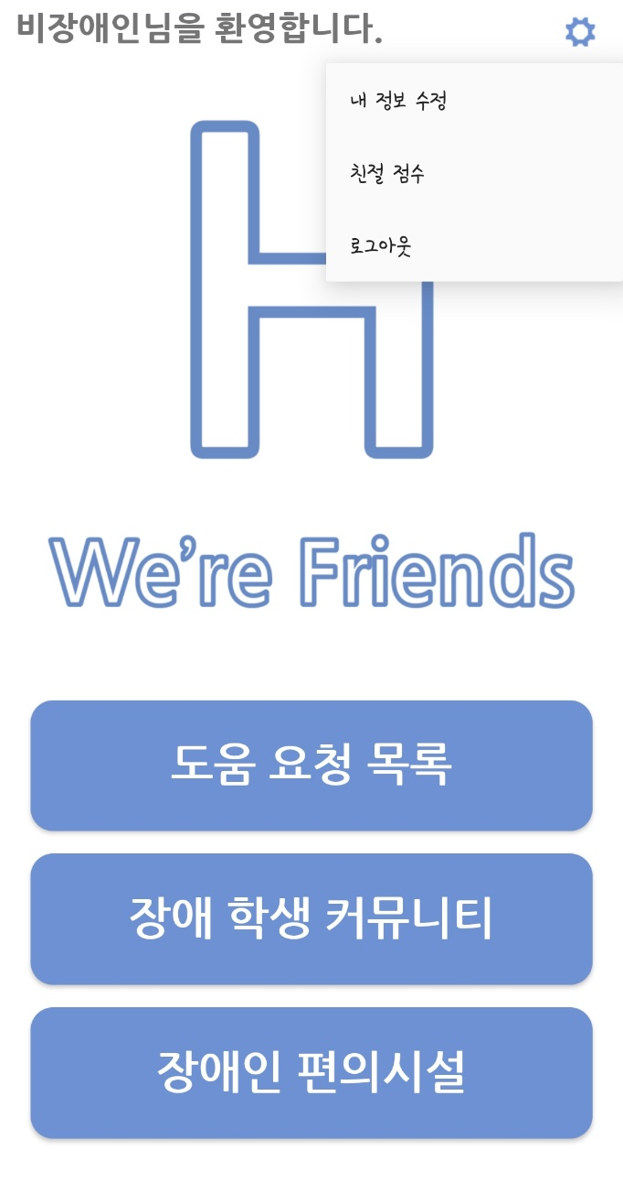
3. Description of how the app works
Ask for Help
Disabled
Non-disabled
<MainActivity>
<MainActivity>

Slide 21
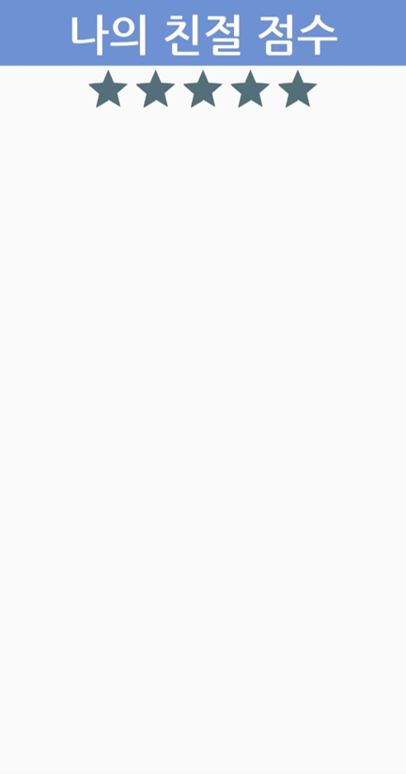
3. Description of how the app works
Ask for Help
Disabled
Non-disabled
<MainActivity>
<GreatActivity>

Slide 22
3. Description of how the app works
Ask for Help
Disabled
Non-disabled
<MainActivity>
<MainActivity>

Slide 23
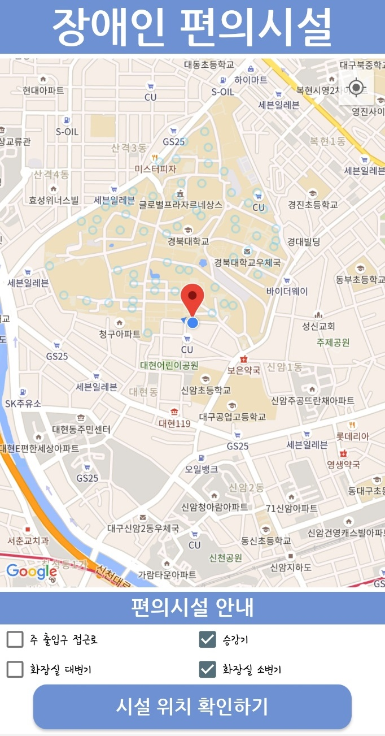
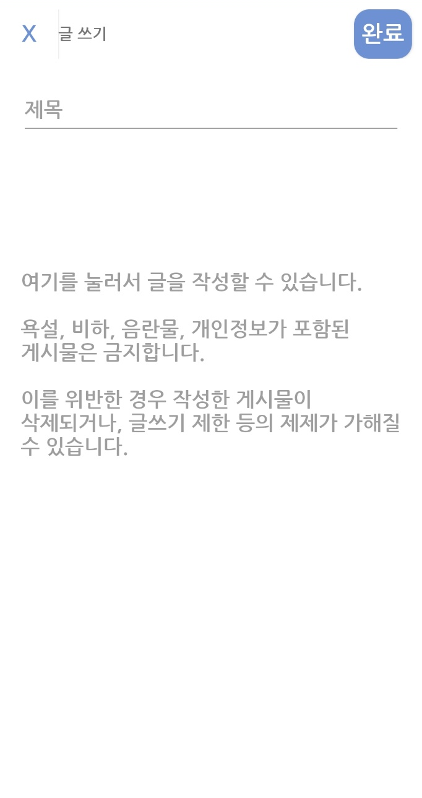
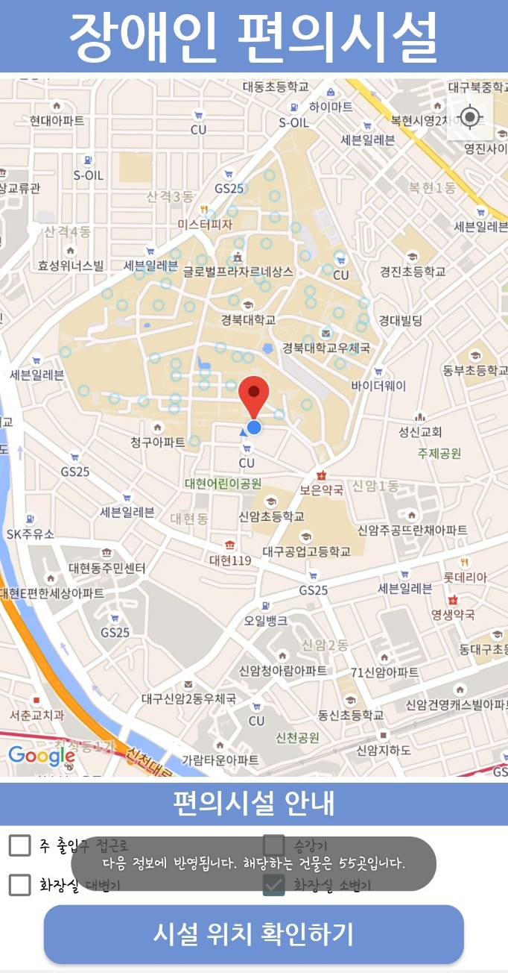
3. Description of how the app works
Community for the Disabled
Accomodations for disabled
<WritingActivity>
<HtrretActivity>

Slide 24
3. Description of how the app works
Community for the Disabled
Facilities for the disabled
<WritingActivity>
<HtrretActivity>

Slide 25
3. Description of how the app works
Sign up
???????

Slide 26
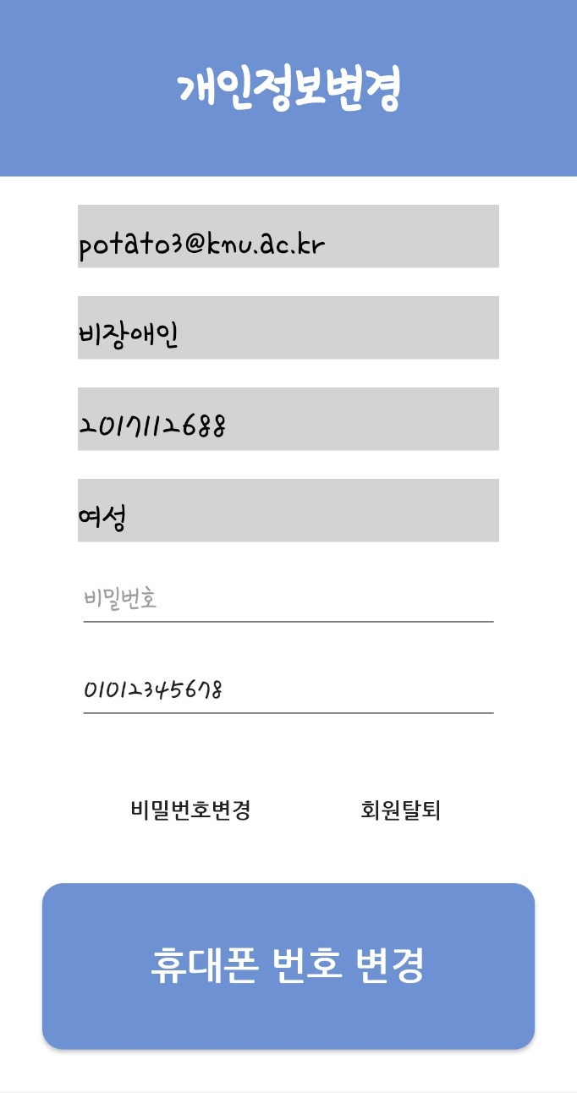
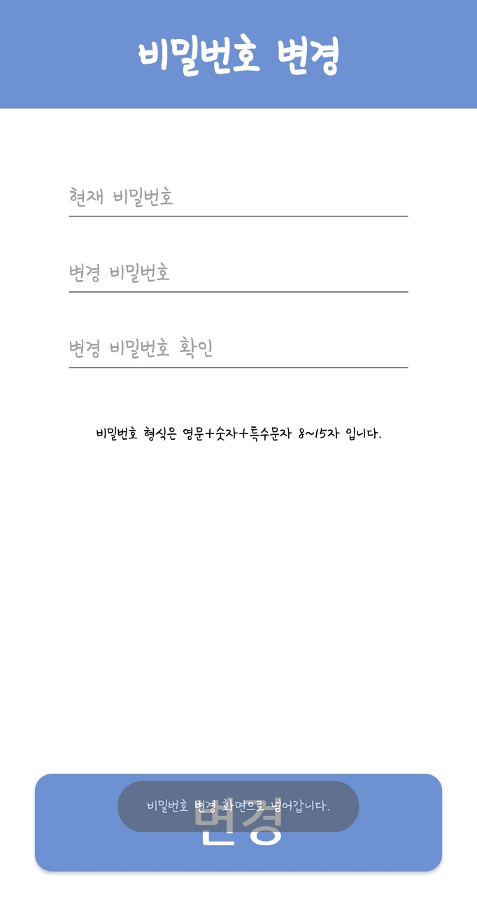
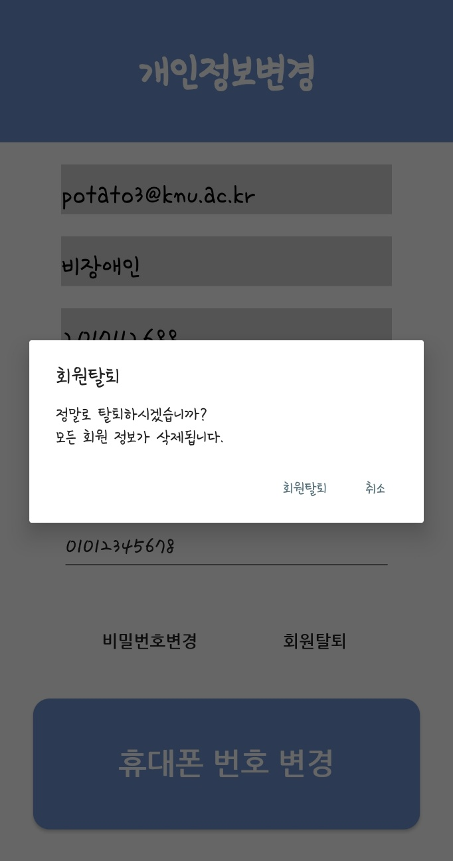
3. Description of how the app works
Edit Profile

Slide 27
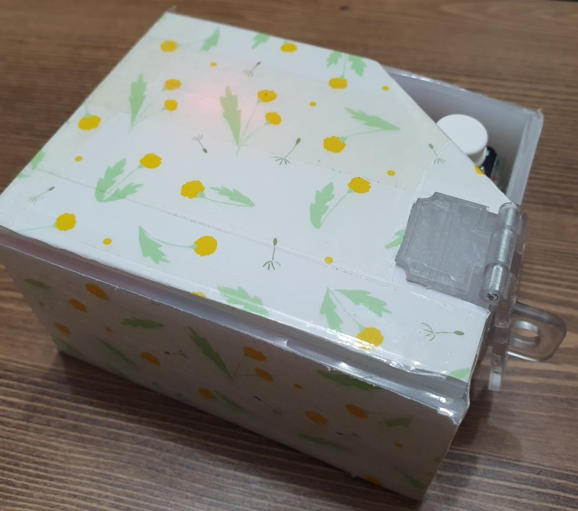
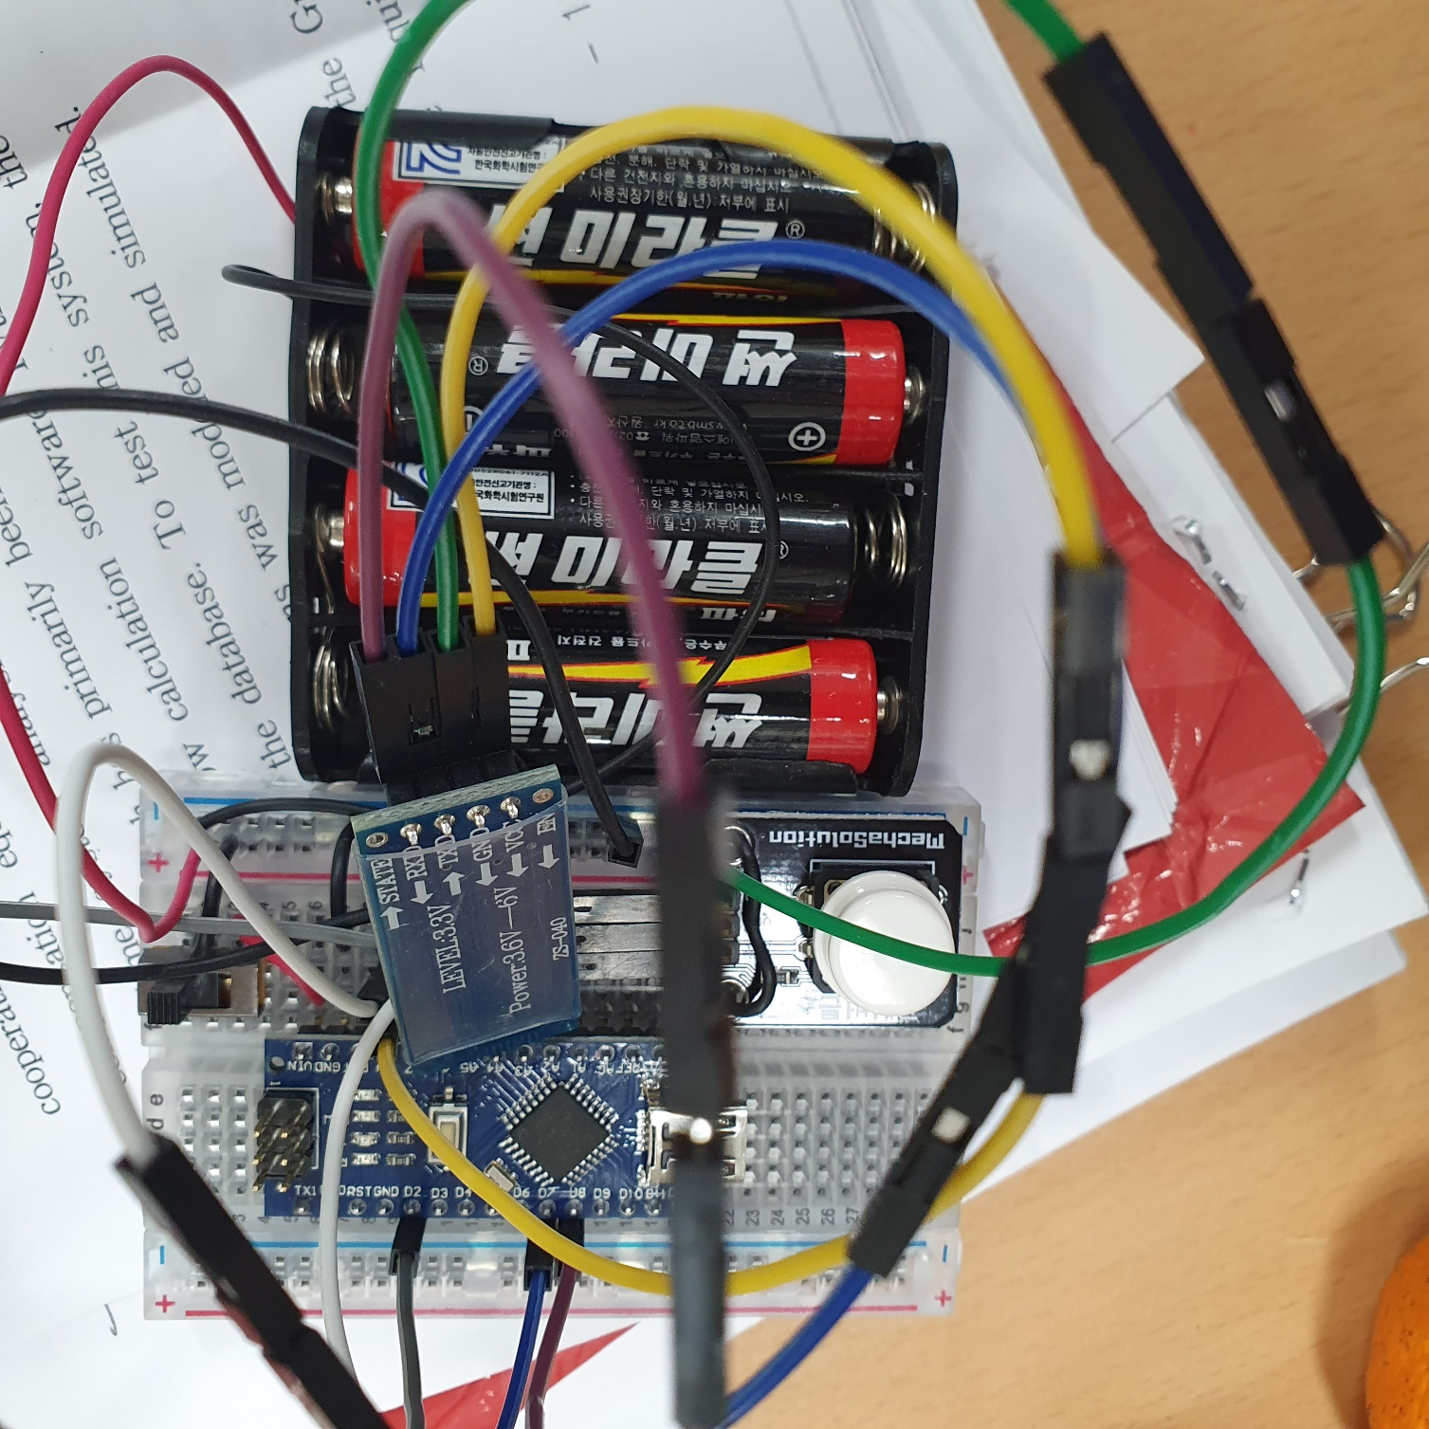
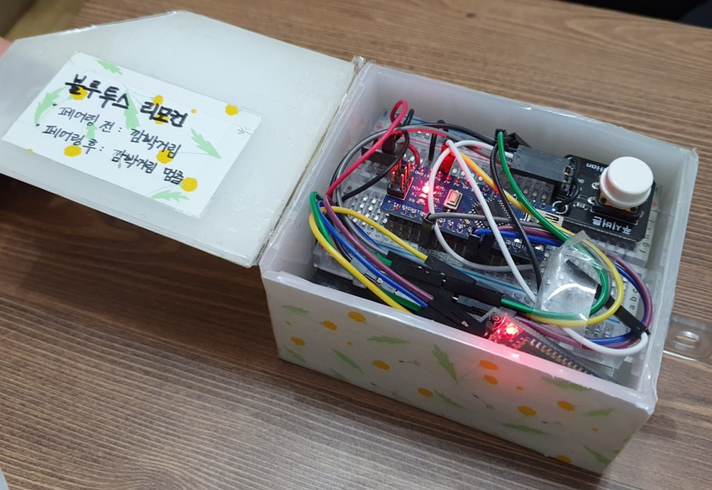
4. Wireless remote controller for the blind
Bluetooth remotecontroller
power
Bluetooth
Switch
Button
Arduino

Slide 28
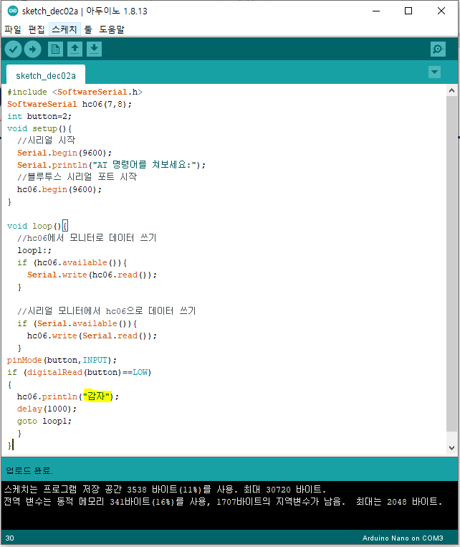
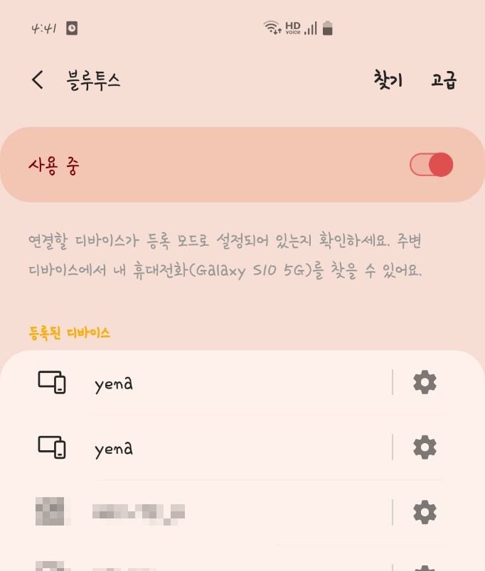
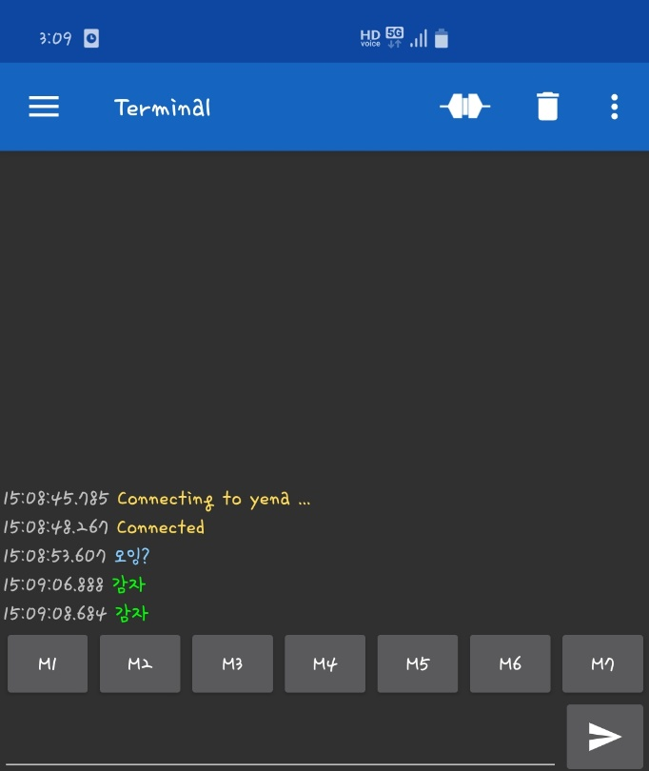
4. Wireless remote controller for the blind
Bluetooth remotecontroller and smartphone
communication
Sending a string through socket

Slide 29
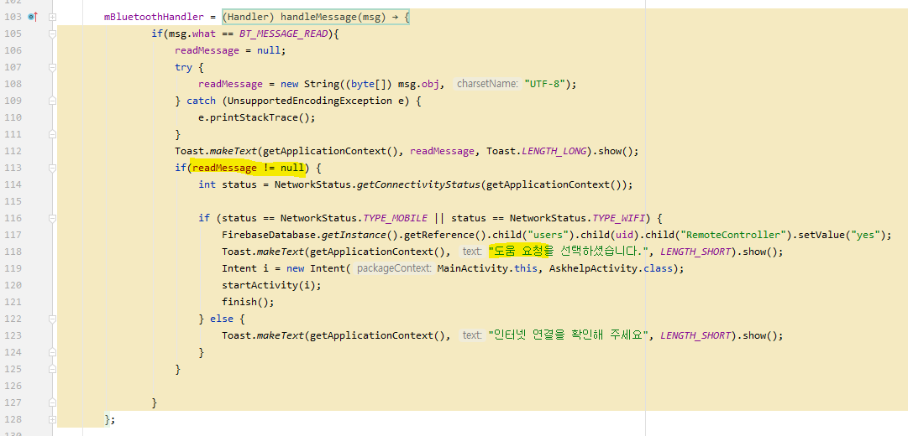
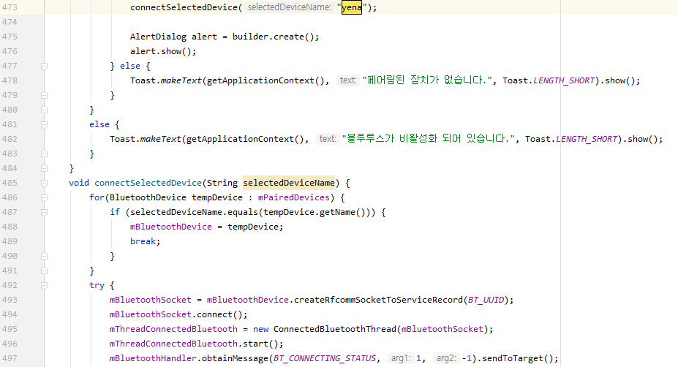
4. Wireless remote controller for the blind
Bluetooth remotecontroller power ON
1. Search and connect devices paired with yena (remotecontroller device name)
Loop through until yena is found

Slide 30
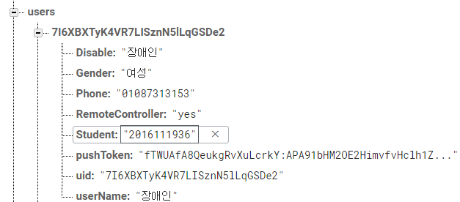
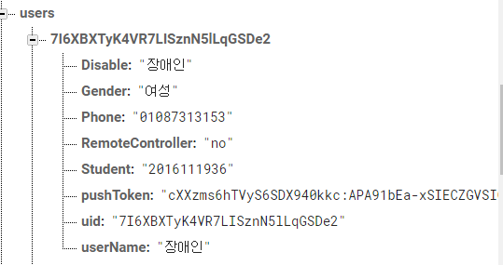
4. Wireless remote controller for the blind
Clicking the Bluetooth remotecontroller button
2. Send message when remotecontroller button is clicked → null(X)
3. Automatically write a request for help (Afterwards, various activities are automatically executed & automatic change of matching status of firebase)

Slide 31
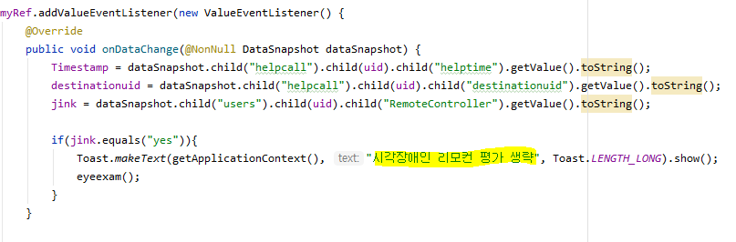
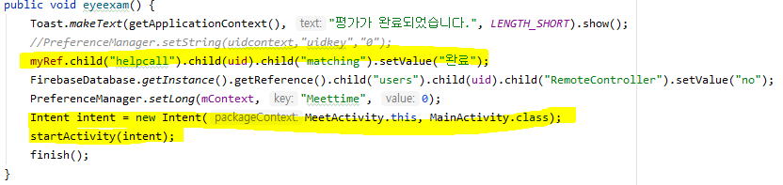
4. Wireless remote controller for the blind
Skip kindness score evaluation
Skip kindness score evaluation
firebase matching status “complete”→ Return to main screen

Slide 32

4. Wireless remote controller for the blind
https://youtu.be/ym7NhnHFuUI

Slide 33



5. Conclusion

Slide 34



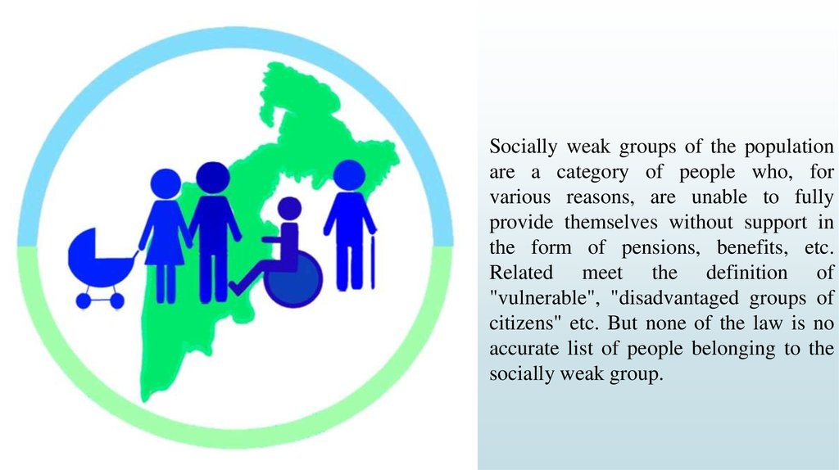
5. Conclusion
Expand

Slide 35



5. Conclusion
Appliance

Slide 36
6. Gantt chart
 | Early September | End of September | Early October | End of October | Early November | End of November | Early December
Google Maps
Pathfinding Algorithm
Device-specific Communication
Community
Error Correction
Bluetooth Remote controller
Midterm
Exam

Slide 37
Q&A
Potatoes.
Thank you!

